Slide 1
ChocolateBar
+ Name : string
+ Brand : string
- Calories: integer
+ChocolateBar()
+ChocolateBar(name:string)
+ChocolateBar(name:string, brand:string, calories:int)
+ eat()
+ giveTo(person:string)

Slide 2
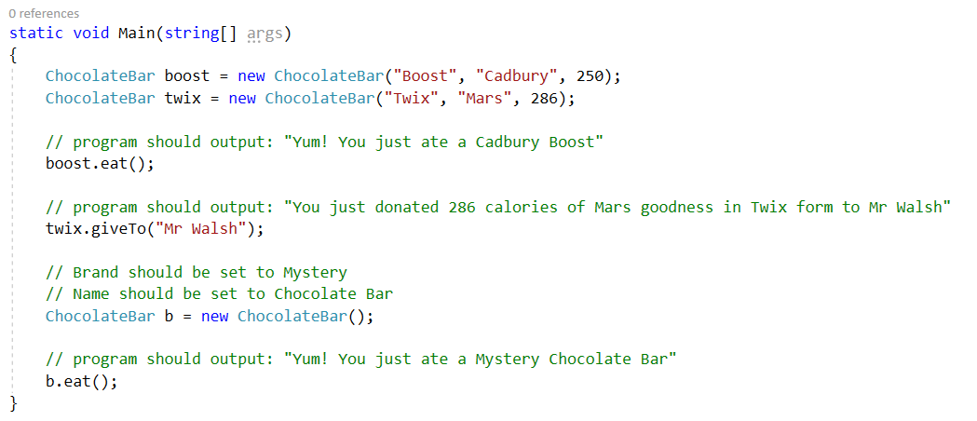
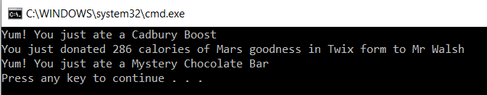
Debug ChocolateBar.cs without changing Program.cs
Expected output:

